Slide 1
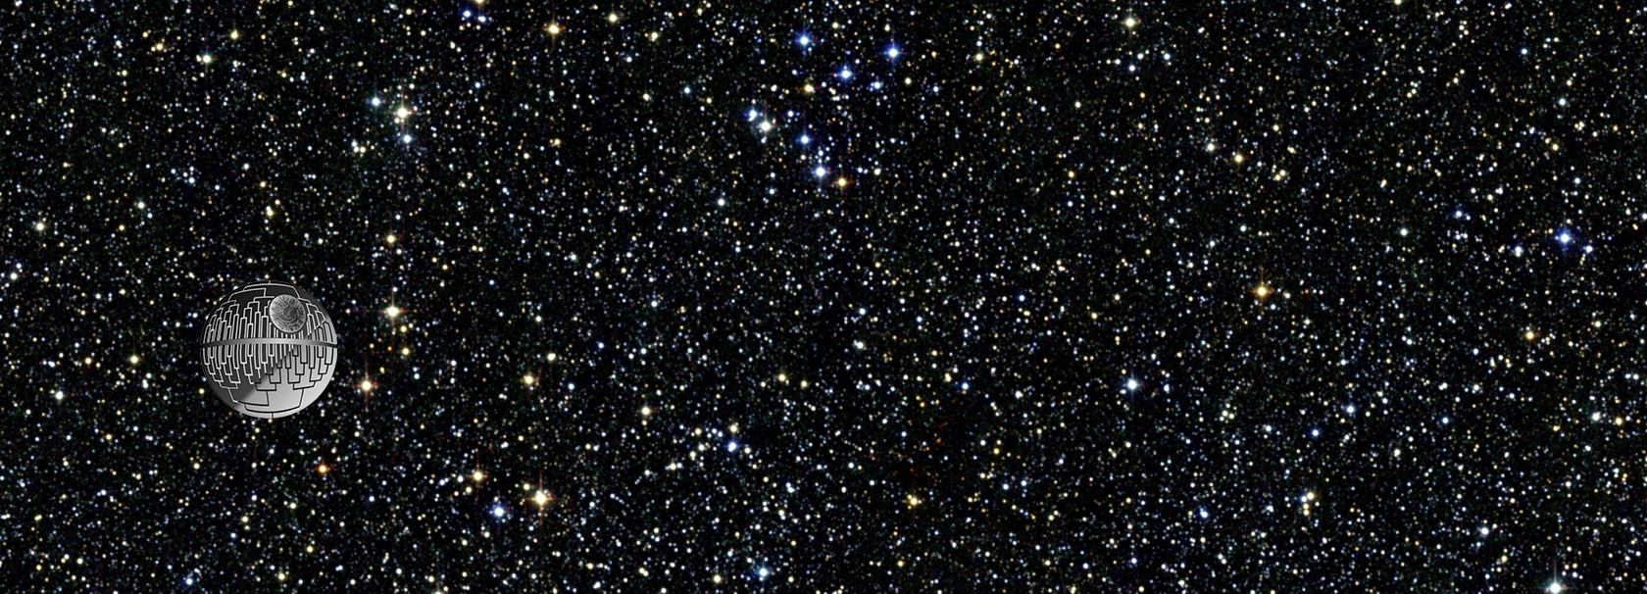
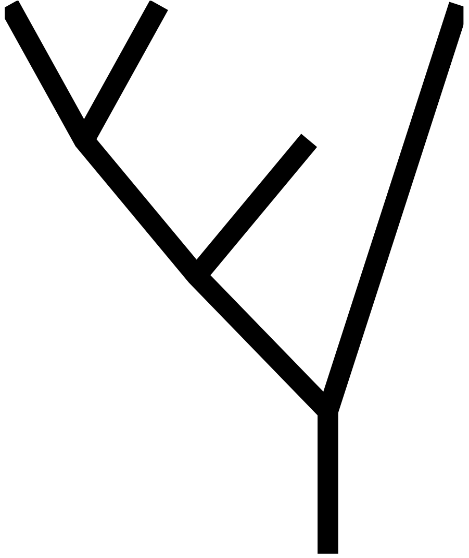
Phylo Seminar 2024

Slide 2
Bayesian inference
It’s all about the prior, man

Slide 3
Bayesian inference
What we want: prob(ourTree | ourData)
But how?? We can calculate prob(ourData | aTree), which we call the likelihood, and pick the tree that makes that probability the greatest (maximum likelihood). But that’s not really what we want.
More generally, we can imagine that our data were produced by some true abstract mystical process (tree) out there, and we’ll never know what it is, but we can sample some data from it and, from that sample, estimate what that process is/was.
But there’s another way…

Slide 4
Bayesian inference
What we want: prob(ourTree | ourData)
But how?? We can calculate prob(ourData | aTree), which we call the likelihood, and pick the tree that makes that probability the greatest (maximum likelihood). But that’s not really what we want.
More generally, we can imagine that our data were produced by some true abstract mystical process (tree) out there, and we’ll never know what it is, but we can sample some data from it and, from that sample, estimate what that process is/was.
But there’s another way…

Slide 5
Bayesian inference
What we want: prob(ourTree | ourData)
But how?? We can calculate prob(ourData | aTree), which we call the likelihood, and pick the tree that makes that probability the greatest (maximum likelihood). But that’s not really what we want.
More generally, we can imagine that our data were produced by some true abstract mystical process (tree) out there, and we’ll never know what it is, but we can sample some data from it and, from that sample, estimate what that process is/was.
But there’s another way…

Slide 6
Bayesian inference
What we want: prob(ourTree | ourData)
But how?? We can calculate prob(ourData | aTree), which we call the likelihood, and pick the tree that makes that probability the greatest (maximum likelihood). But that’s not really what we want.
More generally, we can imagine that our data were produced by some true abstract mystical process (tree) out there, and we’ll never know what it is, but we can sample some data from it and, from that sample, estimate what that process is/was.
But there’s another way…

Slide 7
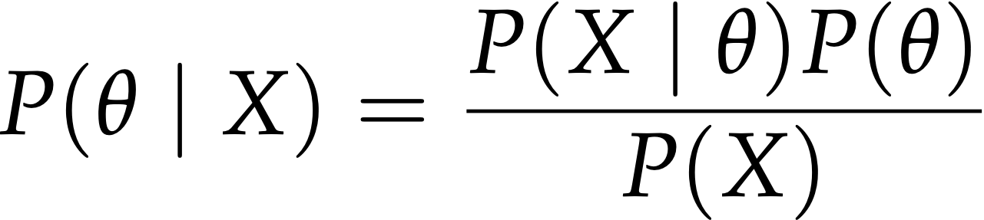
Bayesian inference
What we want: prob(ourTree | ourData)
But how?? We can calculate prob(ourData | aTree), which we call the likelihood, and pick the tree that makes that probability the greatest (maximum likelihood). But that’s not really what we want.
More generally, we can imagine that our data were produced by some true abstract mystical process (tree) out there, and we’ll never know what it is, but we can sample some data from it and, from that sample, estimate what that process is/was.
But there’s another way…
Bayes Theorem!

Slide 8
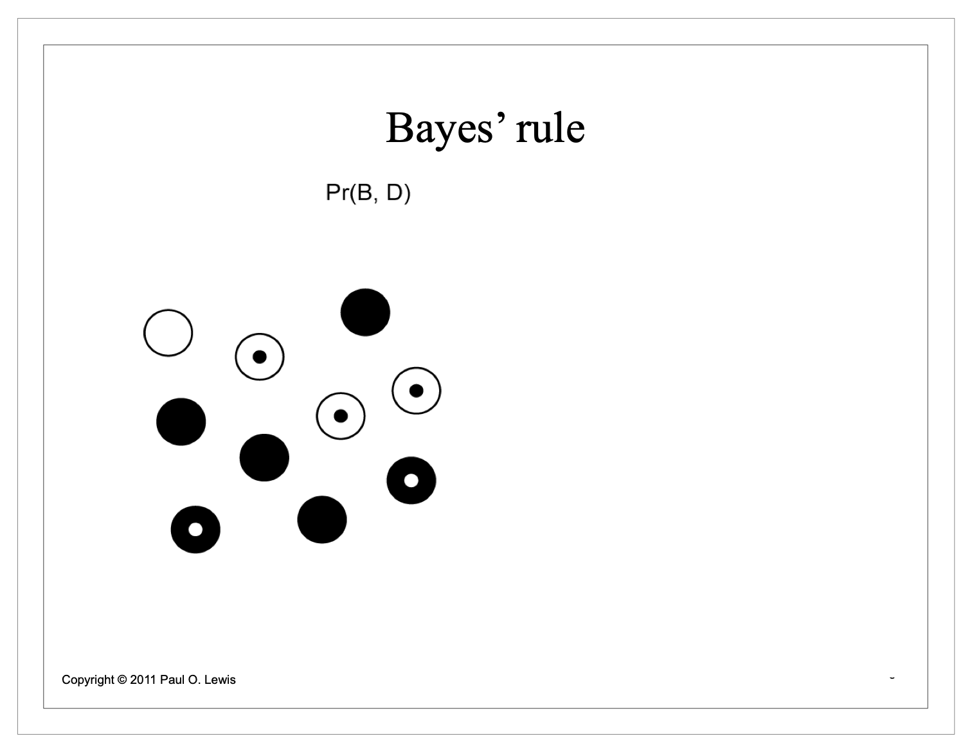
What is this Bayes’ theorem black magic?

Slide 9
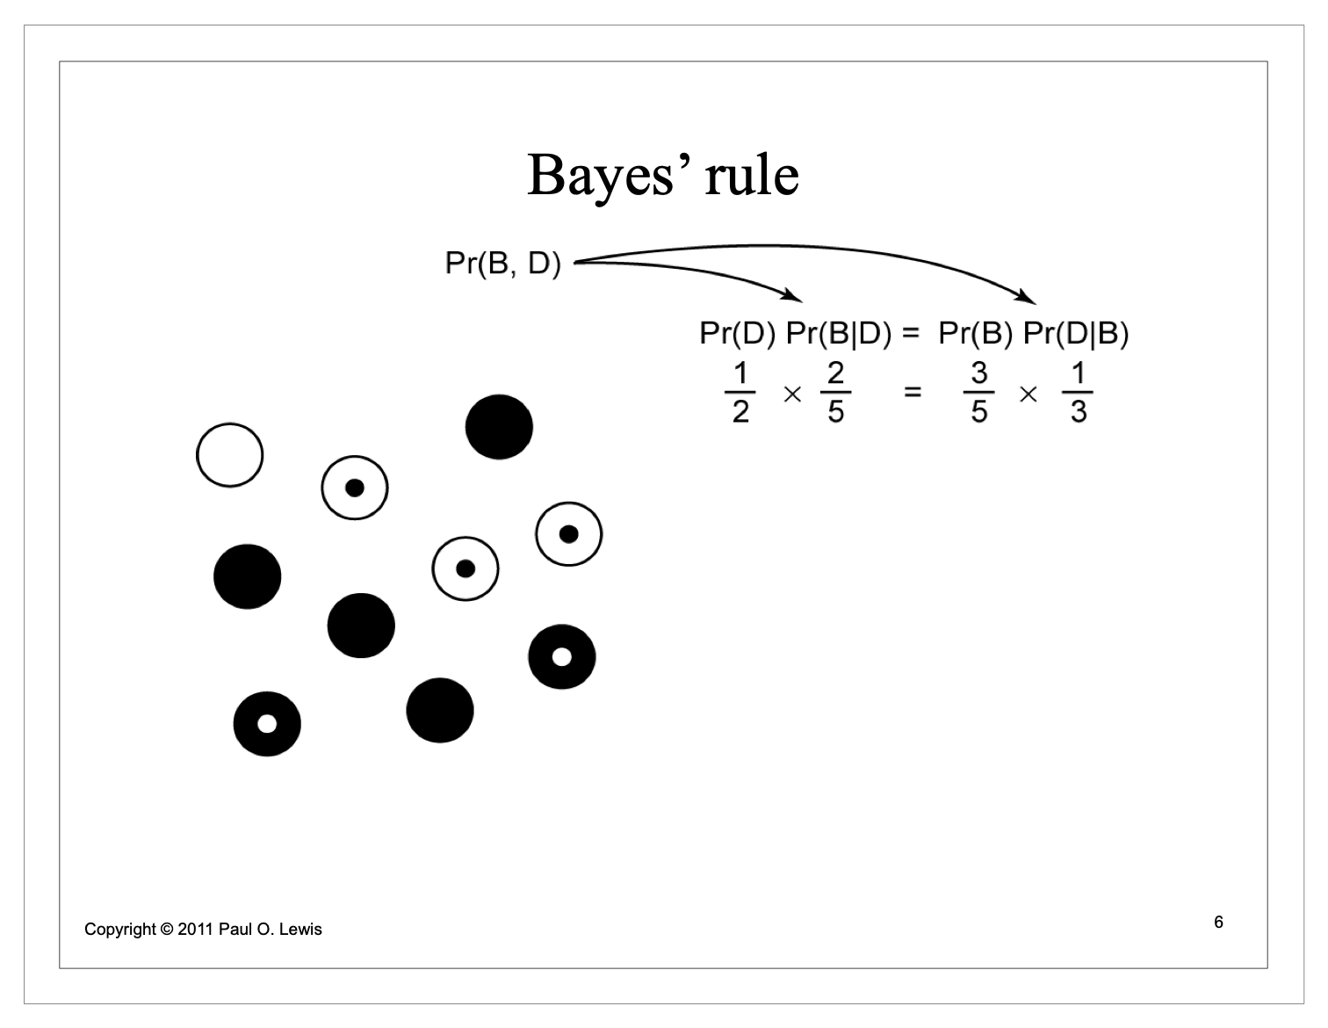
What is this Bayes’ theorem black magic?

Slide 10
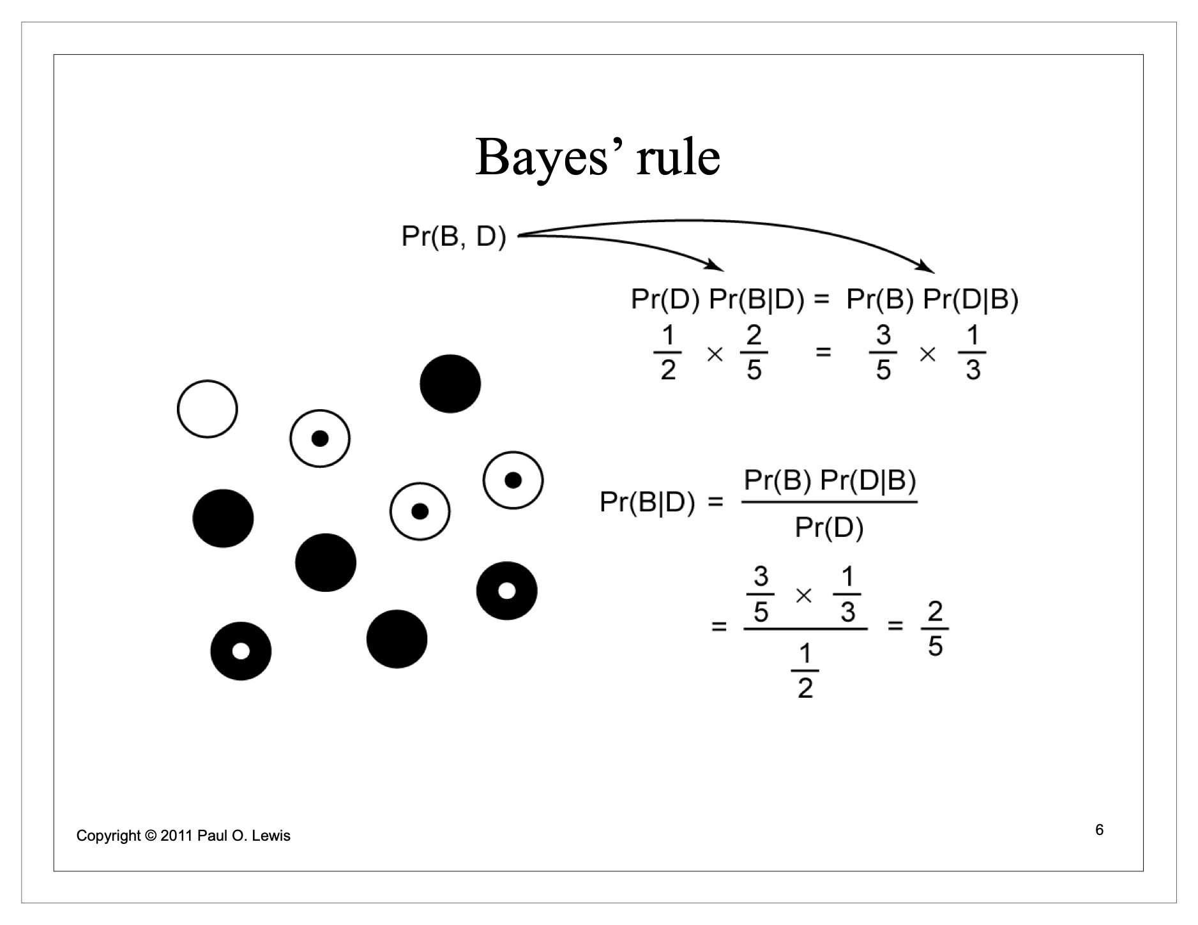
What is this Bayes’ theorem black magic?

Slide 11
To do Bayesian inference, we apply Bayes’ theorem:
data
Slides courtesy of Mike May

Slide 12
To do Bayesian inference, we apply Bayes’ theorem:
parameter(s)
(really, parameter values)
Slides courtesy of Mike May

Slide 13
We specify a prior that describes our belief about plausible parameter values before we observed the data.
prior
(prior probabilities for all our parameter values--ie, a prior probability distribution for each parameter)
Slides courtesy of Mike May

Slide 14
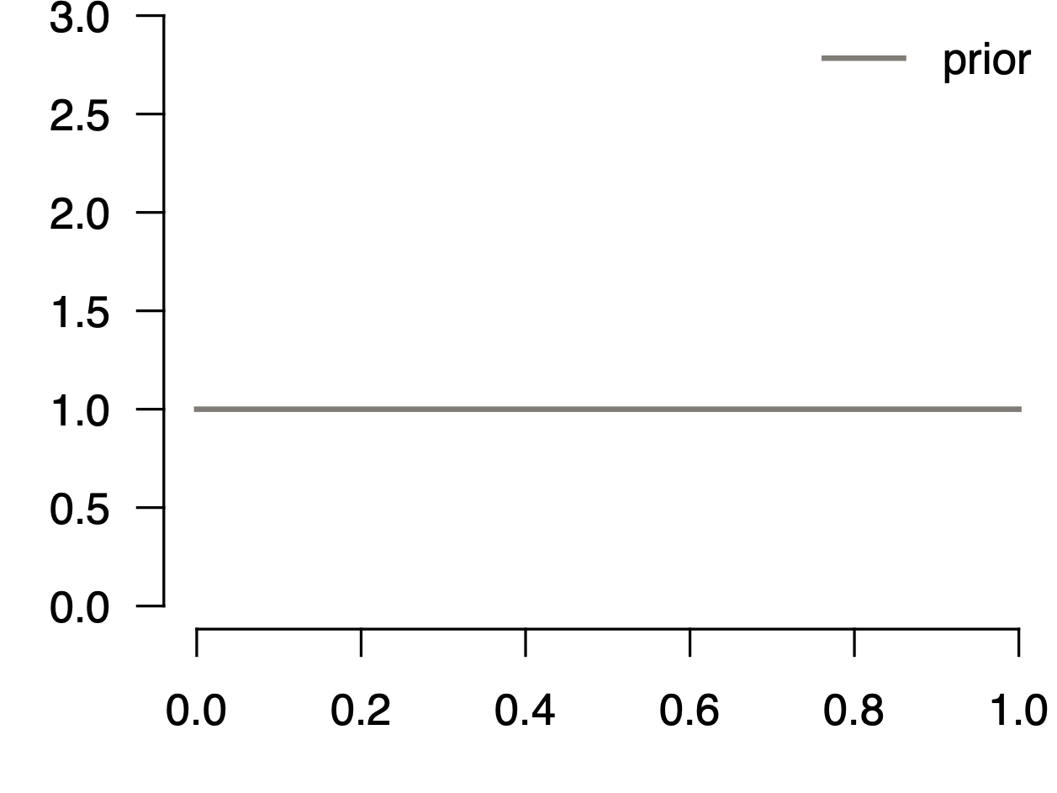

We specify a prior that describes our belief about plausible parameter values before we observed the data.
prior
probability density
Slides courtesy of Mike May

Slide 15
We specify a likelihood function (a model) that extracts information from the data to update our prior belief…
likelihood
probability density
Slides courtesy of Mike May

Slide 16
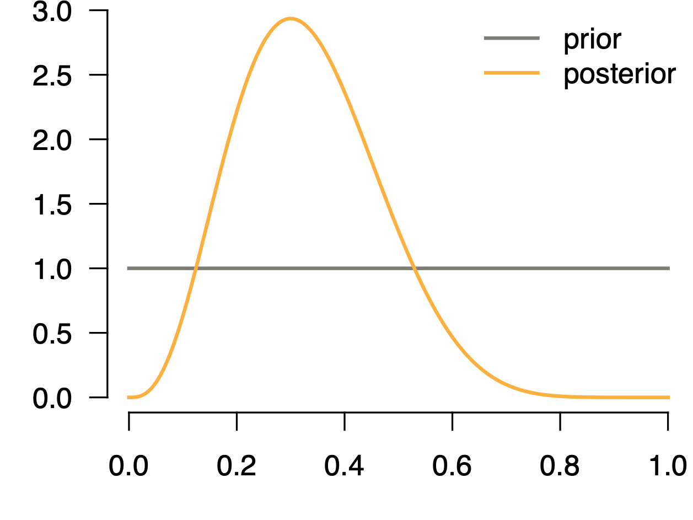
… into our posterior belief about the relative plausibility of different parameter values.
posterior
probability density
Slides courtesy of Mike May

Slide 17
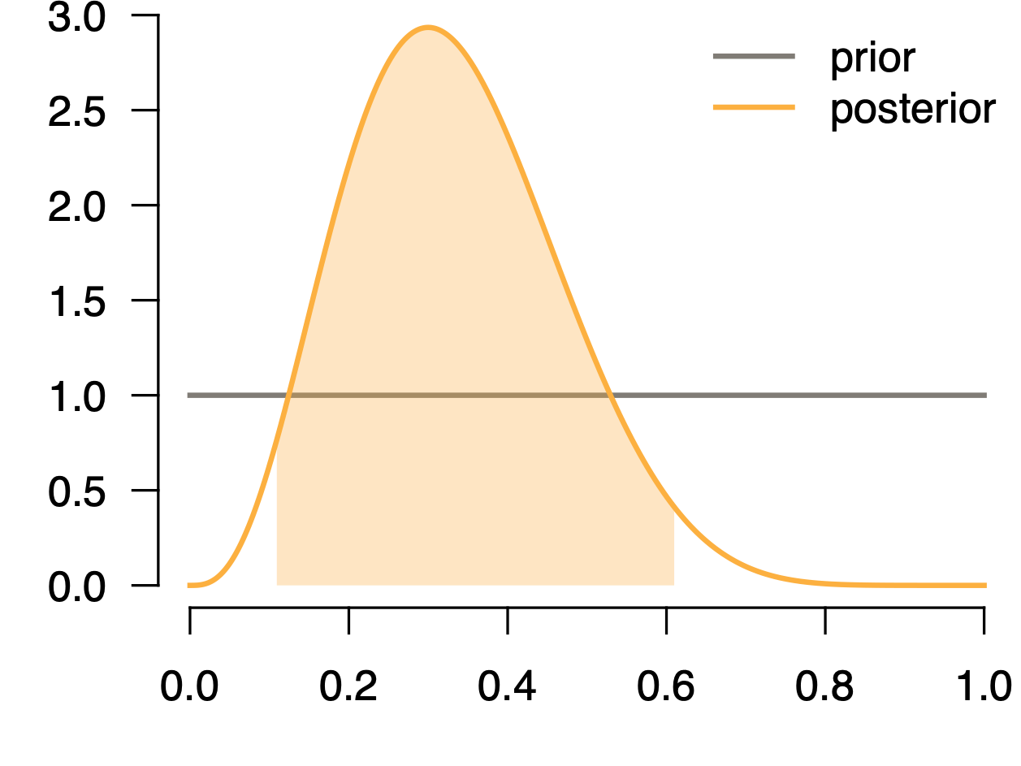
Bayesian Inference
Bayesian Inference
… into our posterior belief about the relative plausibility of different parameter values.
We’re not just interested in the peak of this distribution, but also the uncertainty around it.
posterior
95% credible interval
probability density
Slides courtesy of Mike May

Slide 18
There’s also this thing in the denominator called the marginal likelihood.
marginal likelihood
Slides courtesy of Mike May

Slide 19
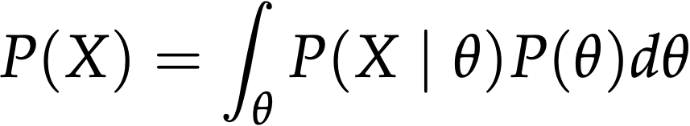
Bayesian Inference
Bayesian Inference
There’s also this thing in the denominator called the marginal likelihood.
This is just a fancy word for the average likelihood, where we weight the likelihoods by their probability under the prior.
marginal likelihood
Slides courtesy of Mike May

Slide 20
Bayesian Inference
Bayesian Inference
Because this quantity involves integration, it’s often impossible to compute directly when there are more than a few parameters.
marginal likelihood
Slides courtesy of Mike May

Slide 21
Bayesian Inference
Bayesian Inference
Because this quantity involves integration, it’s often impossible to compute directly when there are more than a few parameters.
To get around this problem, we use Markov chain Monte Carlo (MCMC) to approximate the posterior distribution.
marginal likelihood
Slides courtesy of Mike May

Slide 22
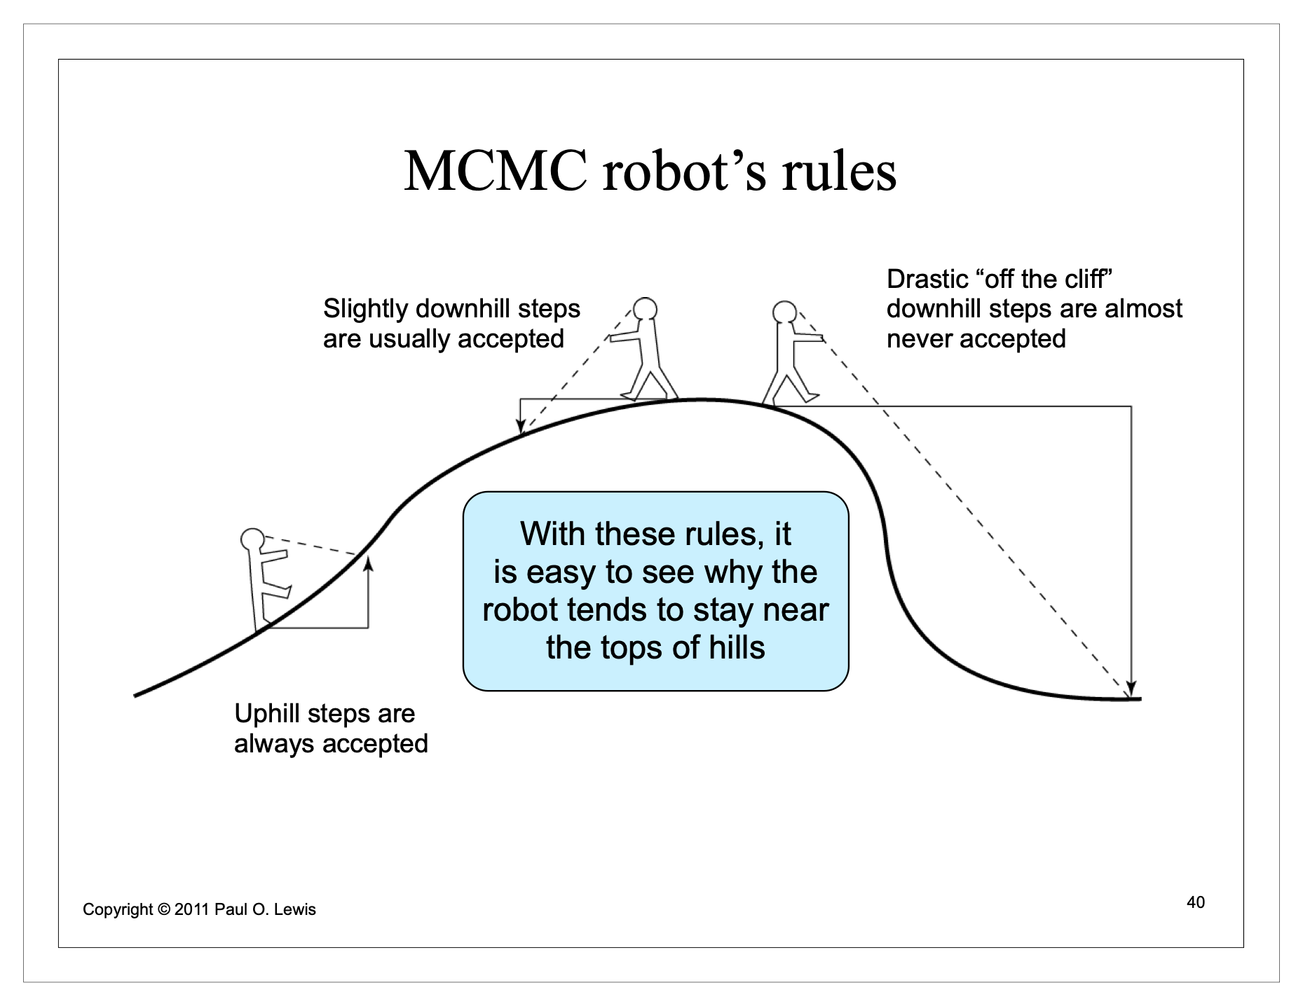
MCMC
Instead of calculating it, MCMC infers the posterior distribution by sampling it

Slide 23
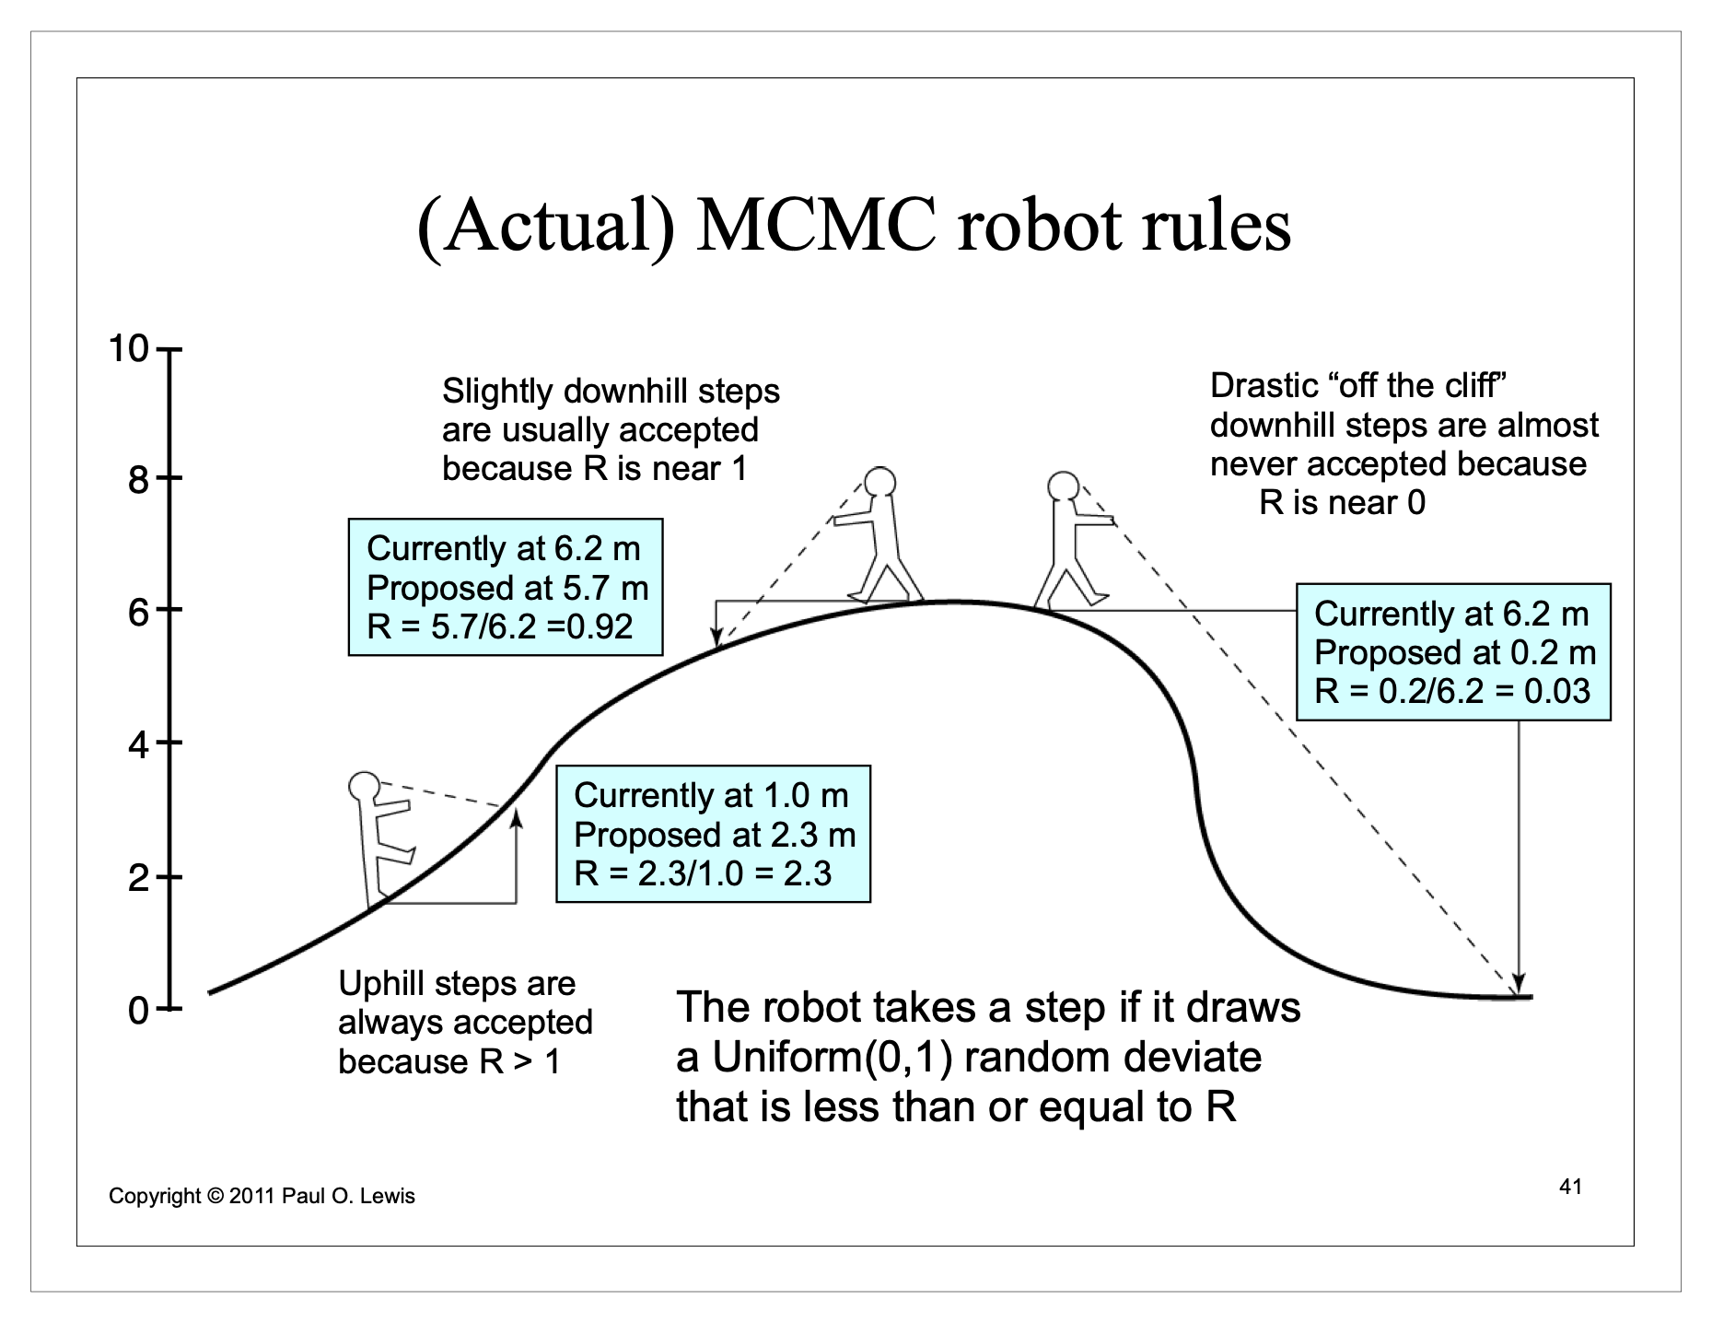
MCMC
Instead of calculating it, MCMC infers the posterior distribution by sampling it

Slide 24
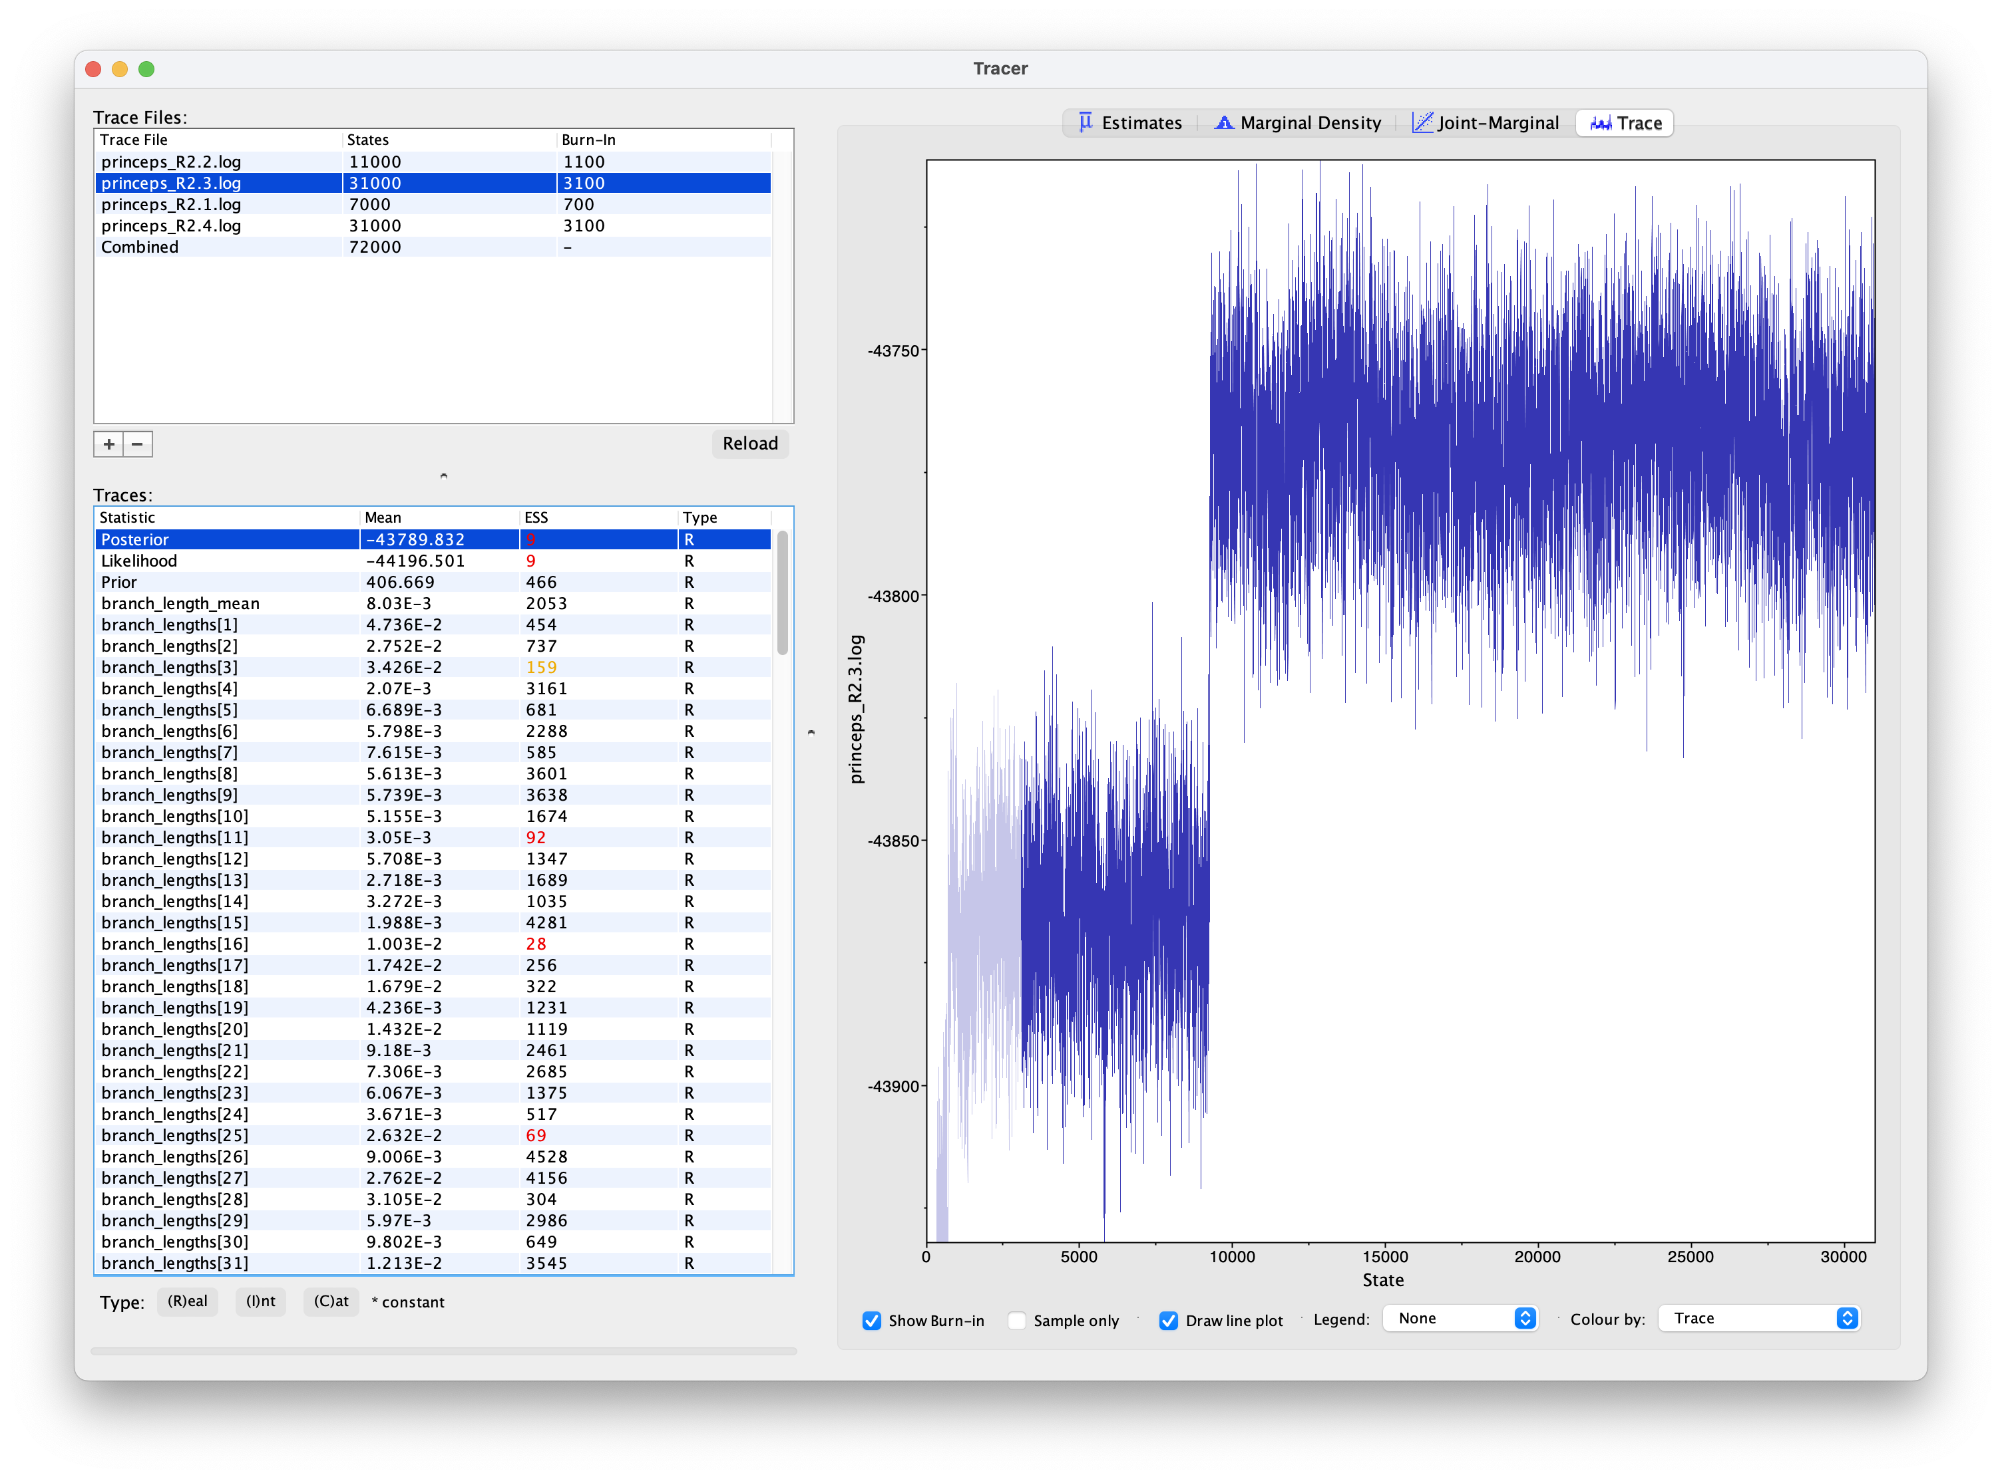
“Convergence”

Slide 25
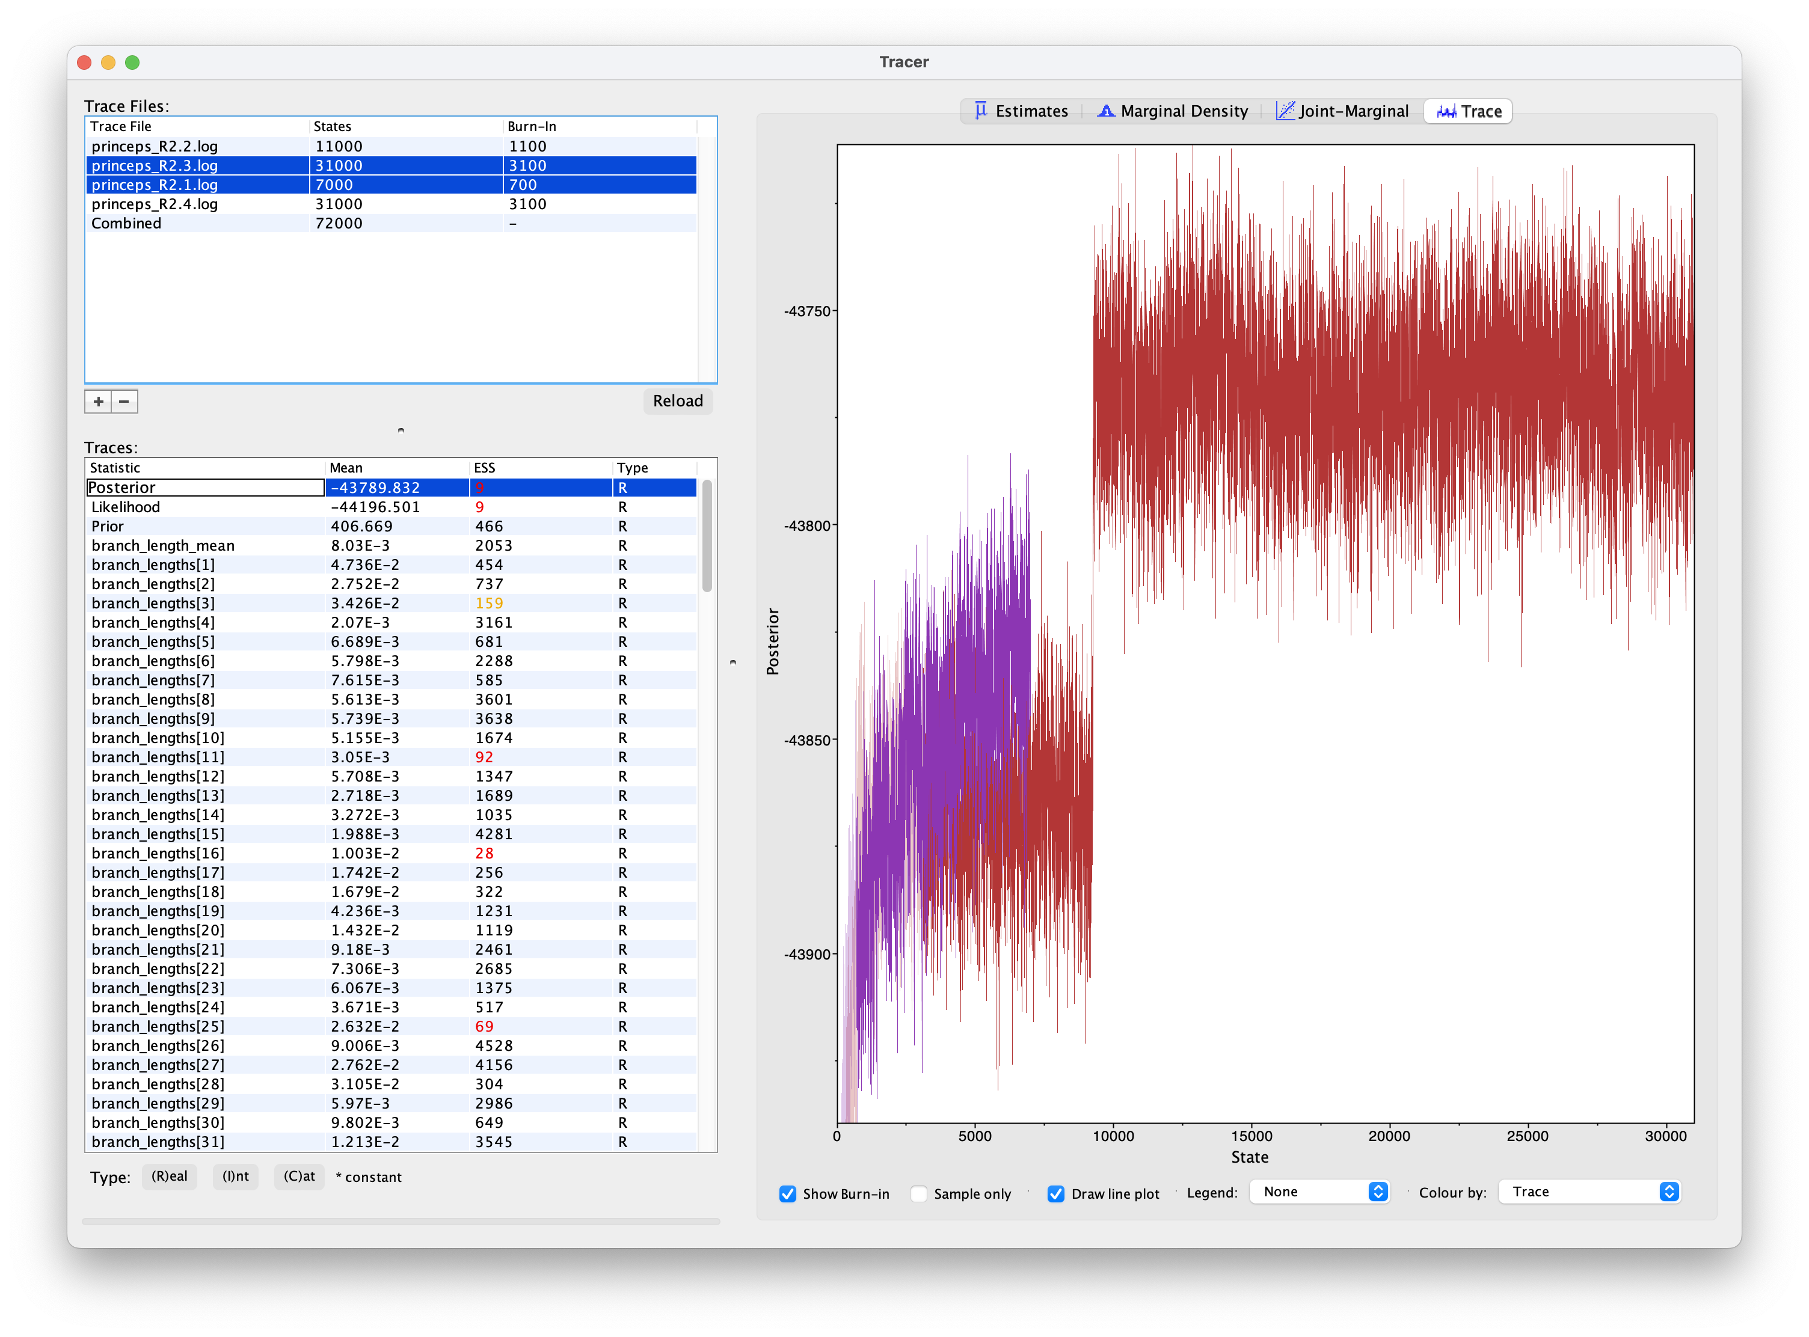
“Convergence”

Slide 26
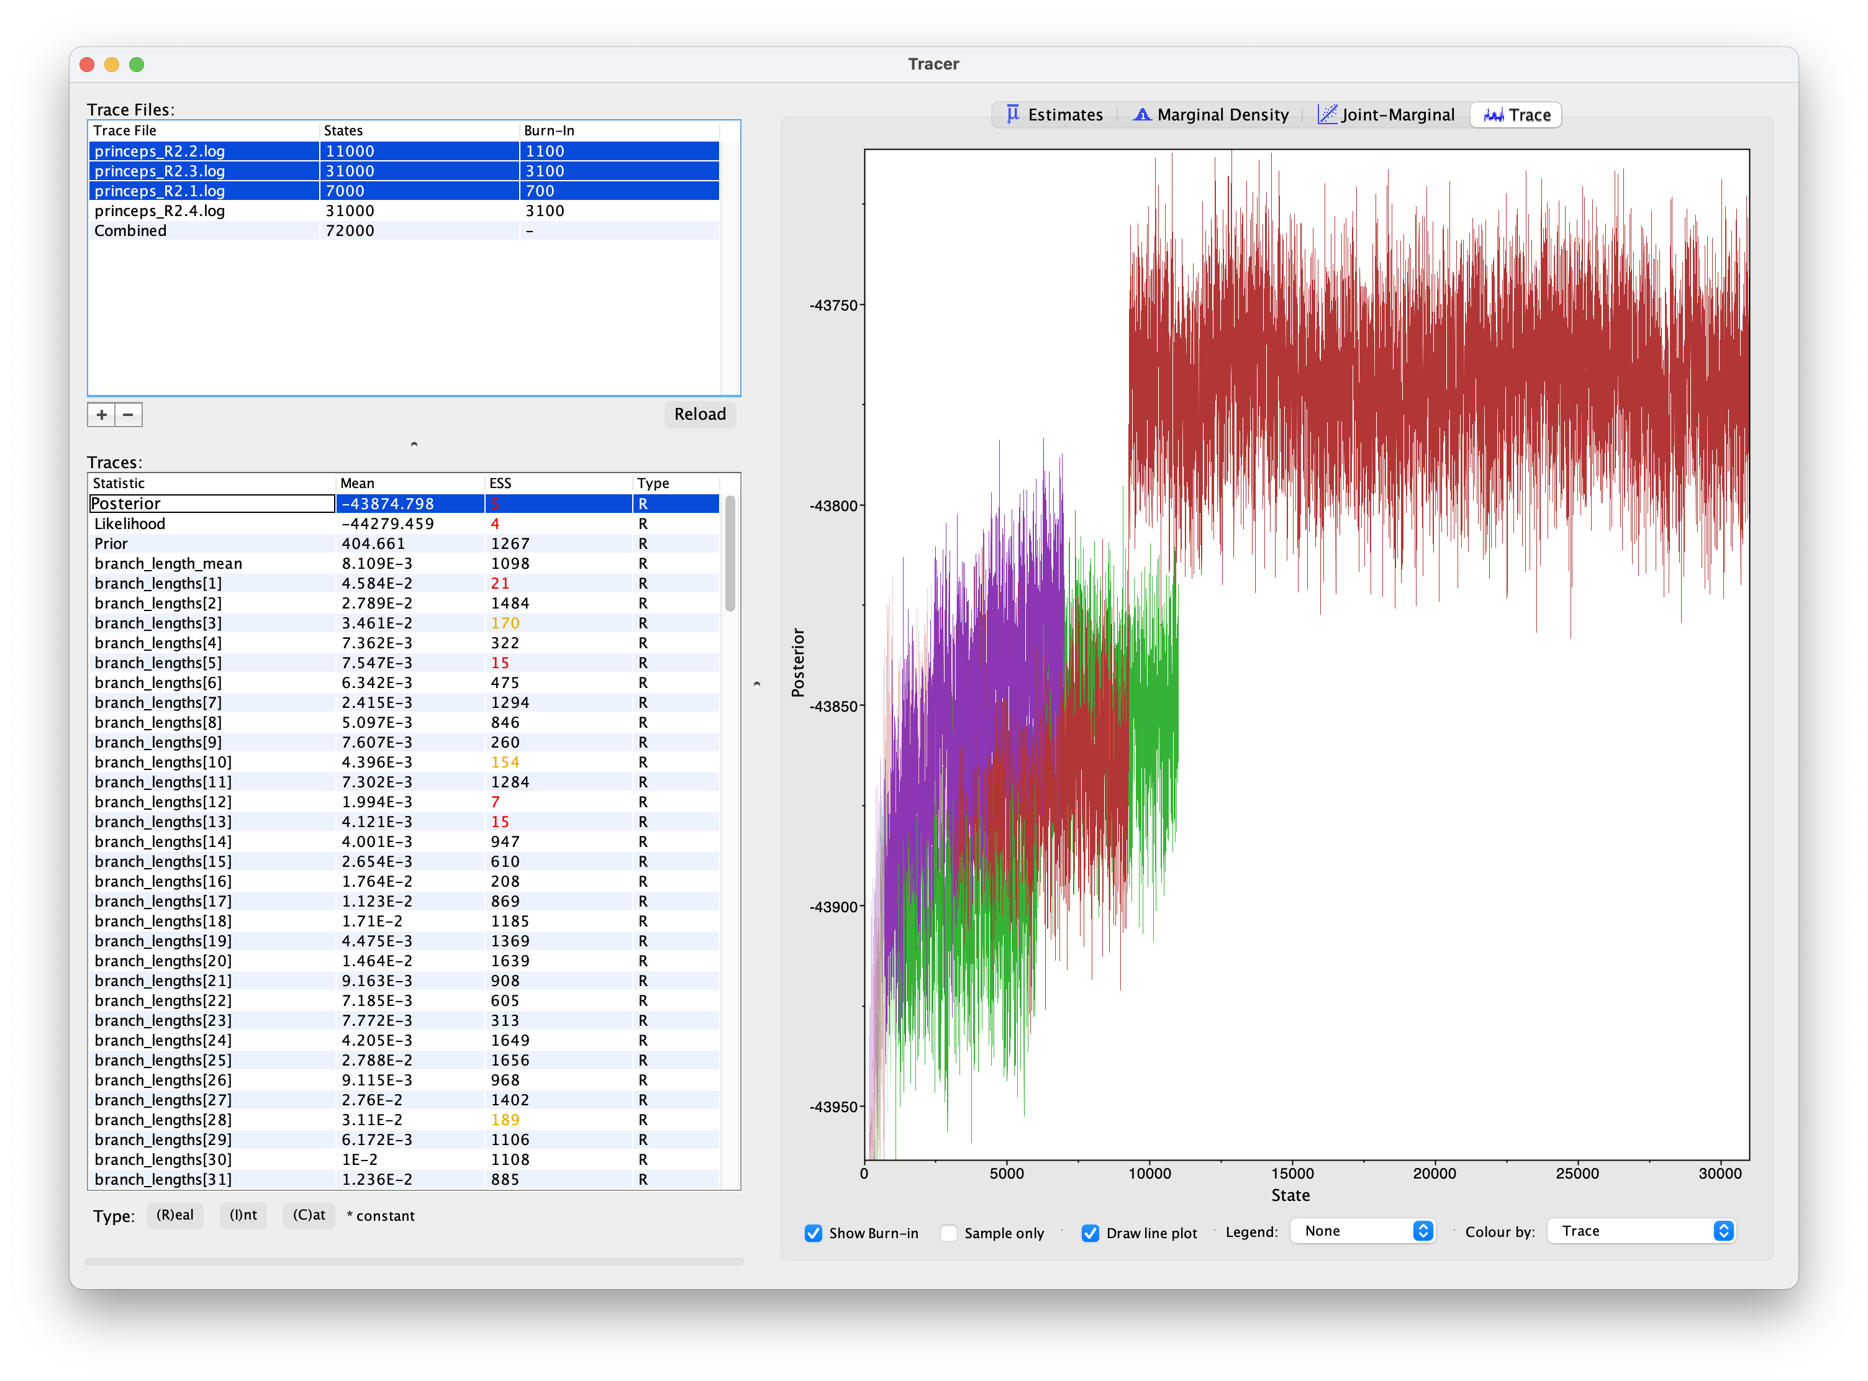
“Convergence”

Slide 27
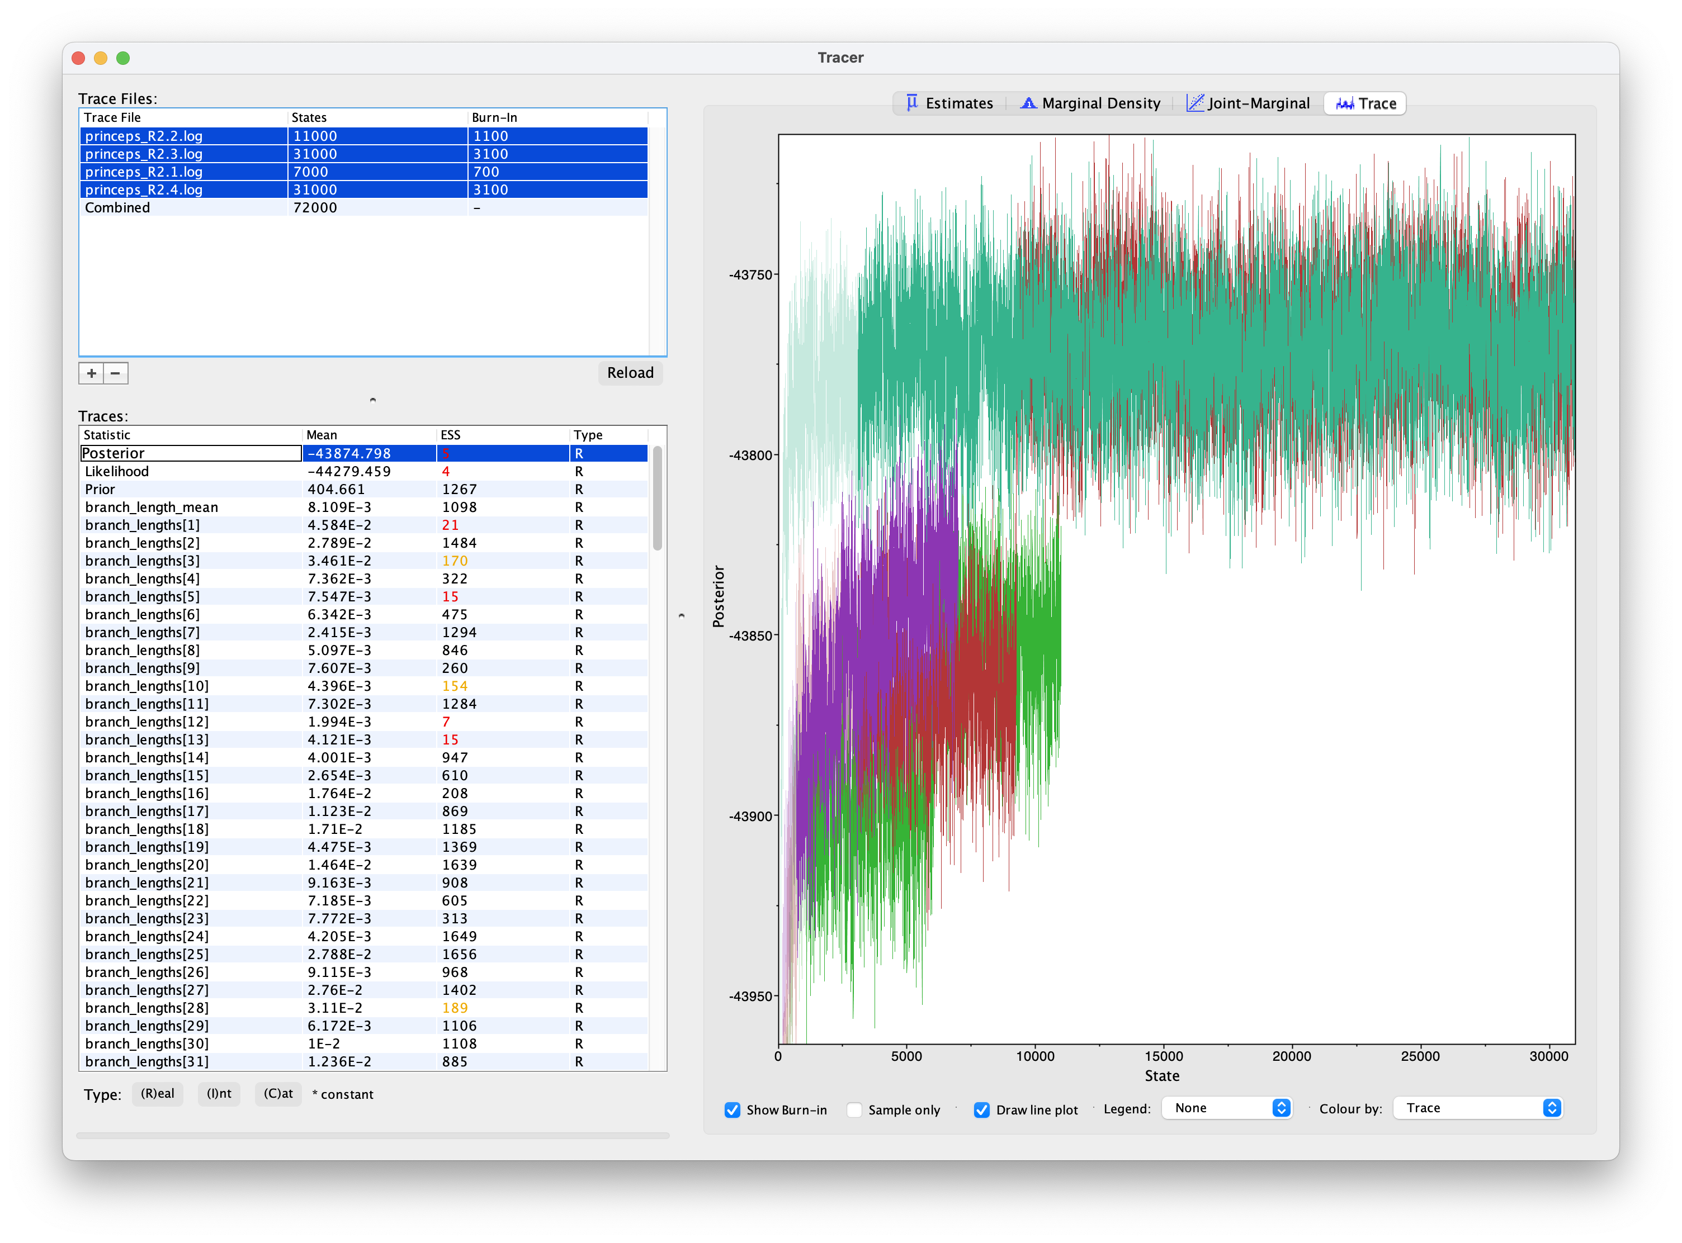
“Convergence”
Mixing
Operators
Tuning
MCMCMC (Metropolis-coupled Markov chain Monte Carlo)

Slide 28
“Convergence”
Dark Arts
Mixing
Operators
Tuning
MCMCMC (Metropolis-coupled Markov chain Monte Carlo)

Slide 29
“Convergence”
Dark Arts
Mixing
Operators
Tuning
MCMCMC (Metropolis-coupled Markov chain Monte Carlo)

Slide 30
“Convergence”
Dark Arts
Mixing
Operators
Tuning
MCMCMC (Metropolis-coupled Markov chain Monte Carlo)

Slide 31
“Convergence”
Dark Arts
Mixing
Operators
Tuning
MCMCMC (Metropolis-coupled Markov chain Monte Carlo)

Slide 32
Bayesian inference of phylogeny
Nitty gritty: BI vs ML
What are the main differences between BI and ML? Both are “model based” and rely heavily on likelihood, so…
BI requires priors!
BI infers the probability of the model (the parameter values) given the data, rather than the other way around
BI infers a distribution; ML provides a point estimate
BI is computationally demanding
BI can be used with models that are too complicated for ML

Slide 33
Bayesian inference of phylogeny
Nitty gritty: BI vs ML
What are the main differences between BI and ML? Both are “model based” and rely heavily on likelihood, so…
BI requires priors!
BI infers the probability of the model (the parameter values) given the data, rather than the other way around
BI infers a distribution; ML provides a point estimate
BI is computationally demanding
BI can be used with models that are too complicated for ML

Slide 34
Bayesian inference of phylogeny
Nitty gritty: BI vs ML
What are the main differences between BI and ML? Both are “model based” and rely heavily on likelihood, so…
BI requires priors!
BI infers the probability of the model (the parameter values) given the data, rather than the other way around
BI infers a distribution; ML provides a point estimate
BI is computationally demanding
BI can be used with models that are too complicated for ML

Slide 35
Bayesian inference of phylogeny
Nitty gritty: BI vs ML
What are the main differences between BI and ML? Both are “model based” and rely heavily on likelihood, so…
BI requires priors!
BI infers the probability of the model (the parameter values) given the data, rather than the other way around
BI infers a distribution; ML provides a point estimate
BI is computationally demanding
BI can be used with models that are too complicated for ML

Slide 36
Bayesian inference of phylogeny
Nitty gritty: BI vs ML
What are the main differences between BI and ML? Both are “model based” and rely heavily on likelihood, so…
BI requires priors!
BI infers the probability of the model (the parameter values) given the data, rather than the other way around
BI infers a distribution; ML provides a point estimate
BI is computationally demanding
BI can be used with models that are too complicated for ML

Slide 37
Bayesian inference of phylogeny
Nitty gritty: BI vs ML
What are the main differences between BI and ML? Both are “model based” and rely heavily on likelihood, so…
BI requires priors!
BI infers the probability of the model (the parameter values) given the data, rather than the other way around
BI infers a distribution; ML provides a point estimate
BI is computationally demanding
BI can be used with models that are too complicated for ML

Slide 38
Tree models
We can have distributions of trees too! (which we need if we want to assign probabilities to trees, i.e., do Bayesian inference)

Slide 39
Slides courtesy of Will Freyman

Slide 40
Slides courtesy of Will Freyman

Slide 41
Slides courtesy of Will Freyman

Slide 42
Slides courtesy of Will Freyman

Slide 43
Slides courtesy of Will Freyman

Slide 44
Slides courtesy of Will Freyman

Slide 45
Slides courtesy of Will Freyman

Slide 46
Slides courtesy of Will Freyman

Slide 47
Slides courtesy of Will Freyman

Slide 48
Slides courtesy of Will Freyman

Slide 49
Slides courtesy of Will Freyman

Slide 50
Slides courtesy of Will Freyman

Slide 51
Slides courtesy of Will Freyman

Slide 52
Slides courtesy of Will Freyman

Slide 53
Slides courtesy of Will Freyman

Slide 54
Slides courtesy of Will Freyman

Slide 55
Slides courtesy of Will Freyman

Slide 56
Slides courtesy of Will Freyman

Slide 57
Slides courtesy of Will Freyman

Slide 58
Slides courtesy of Will Freyman

Slide 59
Slides courtesy of Will Freyman

Slide 60
Slides courtesy of Will Freyman

Slide 61
Slides courtesy of Will Freyman

Slide 62
Slides courtesy of Will Freyman

Slide 63
Slides courtesy of Will Freyman

Slide 64
Slides courtesy of Will Freyman

Slide 65
Slides courtesy of Will Freyman

Slide 66
Slides courtesy of Will Freyman

Slide 67
Slides courtesy of Will Freyman

Slide 68
Slides courtesy of Will Freyman

Slide 69
Slides courtesy of Will Freyman

Slide 70
Slides courtesy of Will Freyman

Slide 71
Slides courtesy of Will Freyman

Slide 72
Slides courtesy of Will Freyman

Slide 73
Slides courtesy of Will Freyman

